Slide 1
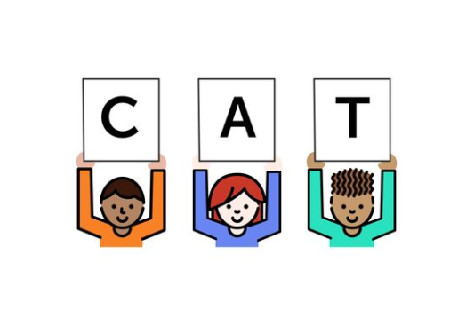
Foundational Skills Mini-Course
Teach and support
T
A
Module 7: Assessment
Notes:
This module was last updated on April 2018.

Slide 2


Course Instructors
David Liben,
Senior Content Specialist
Carey Swanson, ELA/Literacy Specialist

Slide 3
About Student Achievement Partners
Student Achievement Partners is a nonprofit organization dedicated to helping teachers and school leaders implement high-quality, college- and career-ready standards. We believe that challenging academic standards are the foundation for improved student outcomes, but that standards alone are not enough. Students will only make dramatic gains in achievement if instructional materials, assessments, and classroom practices are true to the expectations of high-quality, college- and career-ready standards.
Our work is grounded in research and evidence, and we are committed to sharing standards-aligned tools and practices freely with educators across the country. Our website, achievethecore.org, offers hundreds of math and literacy instructional resources for teachers and school leaders.

Slide 4
Goals for This Module
Explain why assessment is critical to the teaching of foundational skills.
Identify ways to assess daily and weekly that are swift and easy to implement in the classroom.

Slide 5
Print Concepts
Now that we’ve covered what and how, the question is:
K
1
2
Complete
Phonological Awareness
K
1
2
Complete
Phonics and Word Recognition
K
1
2
Have they learned it?
Fluency
K
1
2
Notes:
We have spent the past six weeks looking at all of the aspects of foundational skills instruction. Now it is time to turn our attention to this question: Have students learned it?

Slide 6

The Role of Assessment
“What is probably most important is to tailor training time to student learning by assessing who has and who has not acquired the skills being taught as training proceeds.”
– National Reading Panel
Notes:
It is critical that we are assessing students’ progress frequently– informally daily, and at least once a week more formally—in order to respond to needs and address gaps.
The NRP did not offer time-based guidance, but does explain the important role of assessment

Slide 7

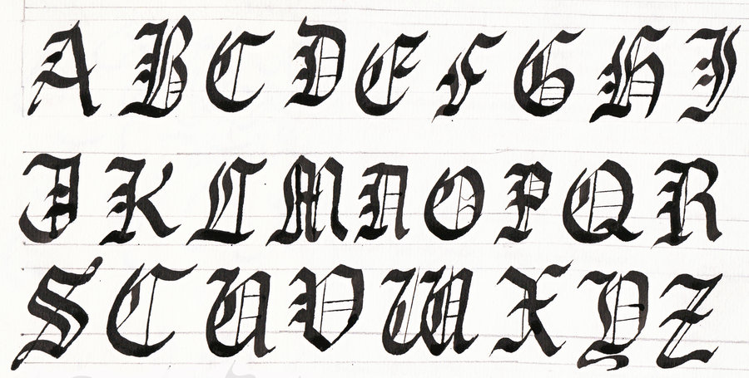



Task Slide
Think back on the skill you acquired over time.
What was the role of the teacher or coach?
Make a list with your colleagues!
Notes:
Last week we asked you to think about the role of practice in skill development. Now– connect this to feedback. What role did the coach or teacher play? Pause to discuss with your colleagues or jot down a list.

Slide 8
The Role of a Teacher or Coach
Notice errors
Provide on-the-spot feedback
Reteach as needed
Support and monitor
Repeat!
Notes:
Here’s what we came up with. Does this match your list?

Slide 9

Assessment Helps You “Coach” Your Team!
With frequent, supportive assessment, students can correct errors and maintain progress.
As needed, teachers can use assessment data to reteach swiftly, ensuring that gaps don’t grow.
Notes:
The big idea here is that assessment helps you coach! You are able to provide feedback, help students correct errors, reteach as needed, and maintain progress.

Slide 10

Assessment Helps You Fill in Gaps When Students Are Missing Instruction
Structures for frequent assessment help the teacher note the needs of students who are absent, late, or missing for any reason and provide a clear reminder of missed skills.
Notes:
Assessment is also useful when students are absent, late, or missing for any reason.
When you are assessing frequently, you develop quick and easy structures to monitor students.
These structures help the teacher note students who are late, absent, or missing, and the related skills that needs to be reinforced.

Slide 11
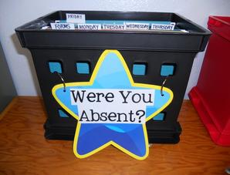
Absent Students
“Student attendance matters for academic performance. The association between poor attendance and lower NAEP scores is robust and holds for every state and for each of the 21 urban districts regardless of size, region or composition of the student population.”
-- Absences Add Up: How School Attendance Influences Student Success
Name | Skill notes | Decodable notes
Chloe | ✓ | ✓ very strong
Keenan | ✓ | Word by word
Maria | Absent | Absent
Notes:
Student attendance has been found to be directly linked to student performance.
A report from the nonprofit Attendance Works, based on an analysis of NAEP scores, found a robust correlation between attendance rates and performance. (http://www.attendanceworks.org/research/absences-add/)
Progress monitoring doesn’t directly address absentee rates, but it gives teachers a built-in mechanism to track, note, and respond to what students are missing.
Consider the learning from yesterday’s modules. You can’t make up for all missed instruction, but if a student misses a read aloud, they’ll likely be okay. If they miss learning the ‘r’ cluster and are expected to read words containing that sound and spelling pattern, they won’t be.

Slide 12
Assessments Connect to Sequence
Recognize initial consonant sounds
Recognize medial sounds in two-sound words
Recognize all sounds in three-sound words
Notes:
We’ve spoken at length about the importance of a scope and sequence. Missing skills one week will lead to challenges down the road, as illustrated by these examples.
If you can’t recognize initial consonant sounds, it is very unlikely you can do final consonant sounds.
If you can’t do either of these, it is impossible to recognize medial sounds.
If you can’t break a two-sound word into its separate sounds, you are not going to succeed with three-sound words.

Slide 13
Types of Assessment
Notes:
We are going to look at varied types of assessment.

Slide 14
Assessment Guidance
Assessment | Notes | Frequency and Response
Observation Checklist | Informal checklist. | Daily, with immediate on-the-spot feedback and support as needed.
Dictation | Weekly, following assessment protocol. | Weekly, with priorities for small group re-teaching the following week as a response.
Unit Assessment Stop and Check | Based on program or school/district guidance. | Every 4-6 weeks, following the scope and sequence of your program.
Notes:
We are recommending 3 types of assessment: observation checklists, dictations, and more formal unit assessments.
We’ll go into details on the first two now. The Unit Assessment/ Stop and Check is based on the discretion of your school or district unless you use your curriculum’s formal assessments.
(click) Let’s look closely first at observation as assessment.

Slide 15
Informal Observations
Student Name | Extra support needed with (provide skill) | Weekly skill notes | Decodable Readers- accuracy | Decodable Readers – automaticity | Decodable Readers – High- Frequency Words
✓ = mastery
? = inconsistent
X = area of challenge, more practice needed
Found in GDs
Notes:
It is important to keep notes on students informally in order to monitor their progress. A template is provided for this purpose; you can use this, or create your own. These are found in your handout and also in your guidance documents.

Slide 16

Principles of Effective Informal Assessment
Keep it simple! ✓ ? X
Have a plan! Be realistic – you won’t see every student every day, so plans help you prioritize.
Avoid memorizing – pause to jot your notes!
Be strategic: Vary the tasks you are asking students to engage in and monitor based on student need.
Notes:
There are some general principles that we can apply to frequent assessment to make it doable and efficient
Using a simple key can help take quick notes. Our template includes a check for “got it,” a question mark for “inconsistent,” and an X for “reteaching needed.”
Planning the tasks and students involved ensures you are checking for the right data.
While tempting to memorize, that leaves a lot of room for error. Better to give yourself a pause in order to jot down notes to use in the future.
Since the purpose is to monitor student progress, be sure you’re strategic about what you’re observing and who you’re observing. This is not a time for popsicle-stick cold calls.

Slide 17
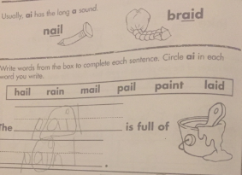
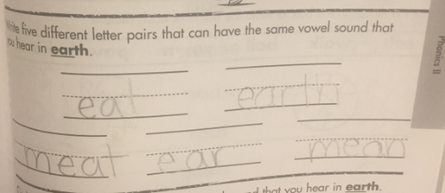
Informal Observations: Student Work
X- more info needed!
✓ Got it!
Notes:
Let’s take a look at how we could track informal observations based in student work. We can see that this student is doing well with the directions here, and the work is accurate. [click] This is a “got it” for today’s practice.
[click]
Looking at this next sample- it looks complete, but the directions are to write different spellings for the “er” sound. That’s not what this student did- they wrote words with the ea spelling, many of which are long e. We need to check this students’ understanding more closely- was it a misunderstanding about the directions, or the sound spellings? [click]

Slide 18
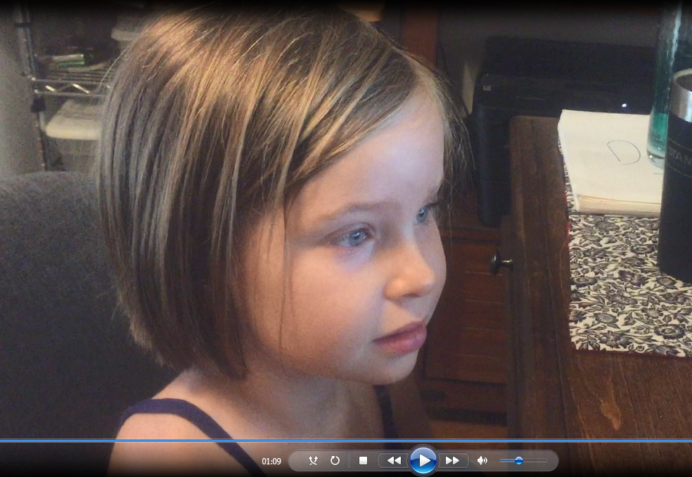
Informal Observations: Students at Work
Student tasks, games, reading, and interactions
Are students accurate?
Are there common errors?
Is there a disconnect between oral/aural and written practice?
Notes:
Think about the work we saw last week, with the decodable reader tasks and games. Informal observations there allow you to gather information about the students– are they accurate? Are they making any common errors? Is there a disconnect between the oral/aural tasks and written practice?

Slide 19
Assessment Guidance
Assessment | Notes | Frequency and Response
Observation Checklist | Informal checklist. | Daily, with immediate on-the-spot feedback and support as needed.
Dictation | Weekly, following assessment protocol. | Weekly, with priorities for small group re-teaching the following week as a response.
Unit Assessment Stop and Check | Based on program or school/district guidance. | Every 4-6 weeks, following the scope and sequence of your program.
Notes:
Now, let’s turn our attention to weekly assessments. (click) Some core programs come with strong weekly assessment that you may wish to use instead of this suggestion. However, we’ve provided an assessment protocol that can work with any program.

Slide 20
Weekly Dictation
Include nonsense words to make sure the sound/spelling pattern is secure!
Protocol:
Dictate 10 words orally
▪ 7-8 words should focus on the weekly sound and spelling pattern.
▪ 2-3 words can focus on previously taught sound and spelling patterns.
Dictate one sentence
▪ The sentence should include 2-3 words that focus on the skill of the current week, along with a mix of new and previously taught high frequency words.
Notes:
A weekly dictation is an easy-to-implement assessment that can be done to check progress related to the week’s sound and spelling pattern. Pause the webinar to go through the protocol and be sure you are clear on what it consists of.

Slide 21
Kindergarten Considerations
Before enough phonics sound/spelling patterns have been taught, modify the dictation to match taught skills.
“I’m going to say a word, you write the letter that makes the first sound.”
“I’m going to say some words with short i and short a in the middle. Write the letter that represents the sounds you hear.”
Notes:
A couple of quick notes about kindergarten: K students won’t be ready for weekly dictations until enough sound/spelling patterns have been taught. Before this, you can modify the dictation to match taught skills. For example, students could write the initial sound they hear in spoken words, or the medial vowel, rather than the whole word.

Slide 22


Guidelines for Responding to Data
Lots of students experienced challenges: Whole Class reteach!
Individual students experienced challenges: Small Group support!
Notes:
Once you’ve given the assessment, it is critical that you have a process for responding.
In general- if there are many errors, you want to address this whole class. If there are outliers in the data, flag this for small group support.

Slide 23

Aim high!
If a skill is not secure for 80 % of the class, address it.
If individual students aren’t mastering sound and spelling patterns are at 80% accuracy, support in small groups or one on one.
Rule of thumb:
Go for 80% or above!
Notes:
We are talking about a lot of content, and we know it must be secure for students to progress, so the rule is aim high. We suggest that, if less than 80% of the class is at mastery, you should address it and, if students are not individually meeting the 80% goal, support them in small groups or one on one.

Slide 24



Different Students, Different Needs
Some students need more practice, others less.
Some students catch on to these skills quickly; others need more time.
This is not a reflection of intellect, but it is an instructional need that must be addressed!
Notes:
Remember, different students have different needs. Some students need more time! Give it to them. This is not a reflection of student intelligence; it simply means that more time is needed for them to grasp the skill.

Slide 25
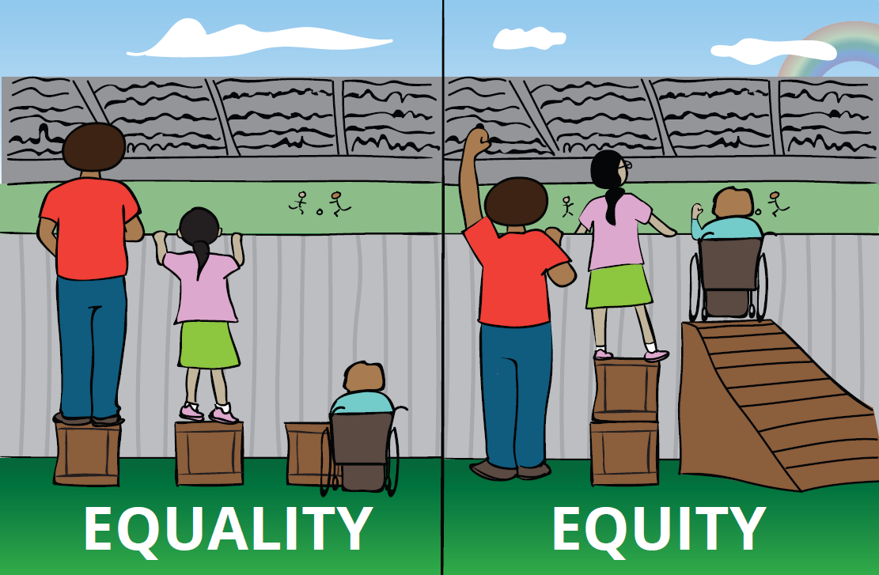
Keep the Pace and Teach with Urgency!
Students can work on more than one skill at the same time!
Replacing grade-level scope and sequence skills with below-level content will result in a huge disconnect between students who keep pace and those who fall behind!
Don’t create “haves” and “have nots” in your classroom!
Notes:
What is especially tricky here is that reteaching can’t mean stopping instruction– remember the urgency around the scope and sequence.
Students can work on more than one skill at the same time!
Replacing grade-level scope and sequence skills with below-level content will result in a huge disconnect between students who keep pace and those who fall behind!
Don’t create “haves” and “have nots” in your classroom!

Slide 26
Sample Data Set: What to Do?
Sample Data: 28 Students
16 students | No errors!
6 students | 7/8 on current sounds, 1-2 errors on previously reviewed sounds, accurate on sentence.
2 students | 2-3 errors on current sounds, with error in sentence.
4 students | less than 5 out of ten, varied errors in dictation and sentence.
Notes:
We’re going to use the sample data on this slide for our online discussion this week.

Slide 27

Online Discussion
What would you do?!
Select one of the groups from the sample data and note what you would plan for the following week’s instruction.
Notes:
Your task is to use the data and make a plan for what you would do the following week with one of the groups to keep your urgency and address the group’s needs.

Slide 28
Assessment Guidance
Assessment | Notes | Frequency and Response
Observation Checklist | Informal checklist. | Daily, with immediate on-the-spot feedback and support as needed.
Dictation | Weekly, following assessment protocol. | Weekly, with priorities for small group re-teaching the following week as a response.
Unit Assessment Stop and Check | Based on program or school/district guidance. | Every 4-6 weeks, following the scope and sequence of your program.
Notes:
The last tier of assessment is some sort of unit assessment. This is a chance to collect more formal data about student mastery over time.

Slide 29
Unit “Stop and Check”
There are 3 options for a more formal unit assessment:
Curricular Unit Tests (e.g., core program Unit Assessment)
Formal District Assessments (e.g., Fastbridge, Dibels, NWEA)
Expanded Dictations
Rule of thumb:
USE the data that reflects your teaching!
Notes:
There are 3 options for a more formal unit assessment.
The decisions about more formal assessments are often based on the needs of a school or district.
Ideally, a formal assessment would give you more information about student performance on taught skills. If this is the case, analyzing that data will help ensure that your weekly assessment, coupled with small group support, is working and that the skills are maintained over time.
If your assessment does not give you this detailed information, or if the scope and sequence doesn’t match taught skills, you may want to create an expanded dictation every 6 weeks or so, spiraling previously taught skills.

Slide 30



What/Where/When/How!?!
Use decodables with ALL students
(whole group)
Small and Flexible groups
Got it!
Read the decodable one more time to ensure mastery
Move to other text
Shaky
Additional Skills practice
Reread decodables
Not there yet
EXTRA skills practice
EXTRA decodable work (old + current)
Notes:
Remember: as you are collecting data, you are responding to students based on their needs. This includes built-in time for extra skills practice as needed.

Slide 31

Module 7: Connect to Practice Task
Option A:
Implement one of the assessment options in your classroom- the observation checklist, or the weekly dictation, and share a summary of the data you ascertain.
OR- summarize the data method you currently use and why it is optimal!
Option B:
Take a look at a school or district that you support for your work. Summarize the phonics assessments that are currently in place, and one recommendation you would make as a result.
Notes:
There are two options for this week’s practice task. One is for those of you within the classroom: we’re asking you to either implement one of the first two assessment options and share your data, or summarize the method you already use and explain why it is optimal. Maybe you all have systems we can learn from!
The other option is to summarize the recommendation you would make for assessment to the school or district you support through your work.

Slide 32
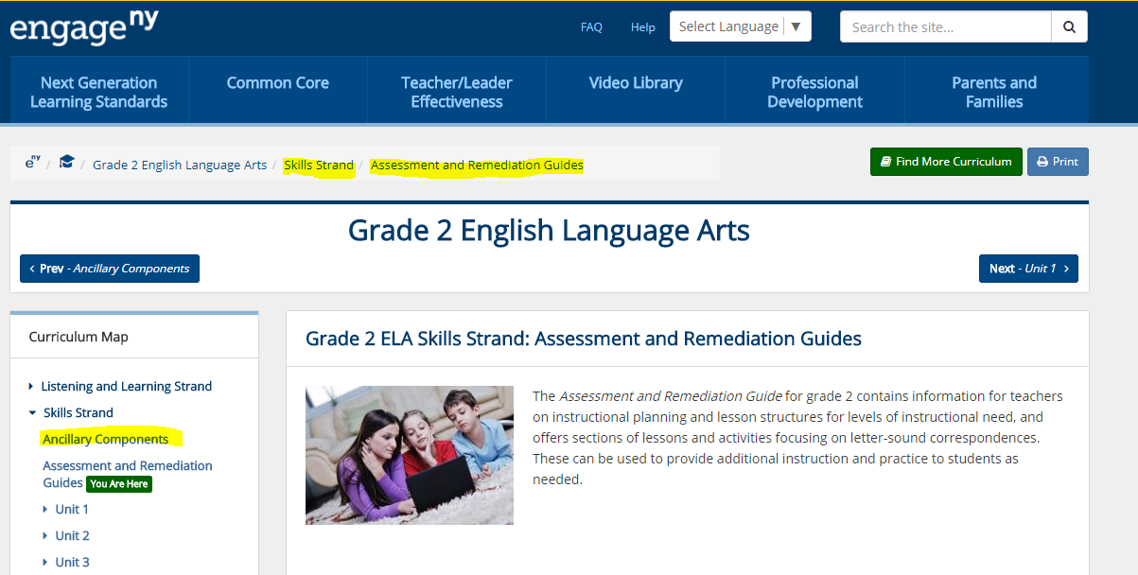
Recommended Resource
CKLA Assessment and Remediation Guide
Grades K-2- Engage New York or Unbounded.org

Slide 33

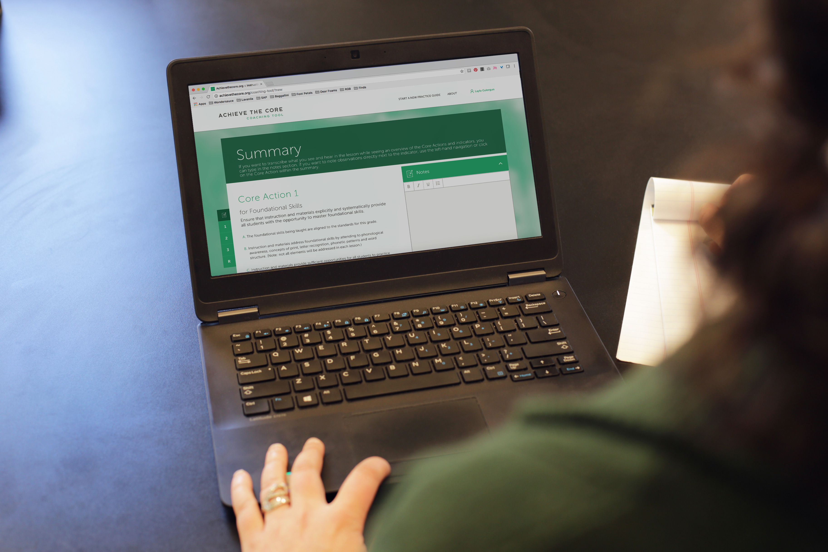

About Achieve the Core
Visit achievethecore.org to find:
Professional Learning Content
PD modules
Research
Aligned Blog
Tools for Planning and Reflection
Instructional Practice Toolkit
Instructional Practice Guide
Lesson Planning Tool
Focus Documents
Alignment rubrics and adaptation guidance
Classroom Resources
Math and ELA lessons
Mini-assessments
Writing resources
Coherence Map
Academic Word Finder

Slide 34

The Core Advocate Network
Who are the Core Advocates?
Core Advocates are educators who:
Believe in the potential of high-quality standards grounded in evidence to prepare all students for college and career.
Understand and embrace the Shifts in instruction and assessment required by college- and career-ready standards.
Are eager to support their colleagues and communities in understanding and translating the Shifts into instructional practice.
What do Core Advocates do?
As instructional advocates, Core Advocates lead other educators in their communities in understanding the Shifts, as well as sharing practices aligned to the Shifts and the standards. Among other actions, Core Advocates:
Lead professional development sessions and professional learning communities.
Create, refine, and share standards-aligned resources with the field.
Advocate for high-quality instruction, instructional resources, and professional learning.
Use and provide feedback on high-quality instructional tools and resources.
How can I get involved?
Join the Core Advocate Network by taking the Core Advocate survey at: www.achievethecore.org/ca-signup
Email coreadvocates@studentsachieve.net with any questions.

Slide 35




Stay Connected
Subscribe for email updates on achievethecore.org
Follow us on social media:
Facebook: facebook.com/achievethecore
Twitter: twitter.com/achievethecore
Pinterest: pinterest.com/achievethecore

Slide 36
Thank You!

